Slide 1

J O I N U S F O R A
Birthday
Party!
C E L E B R A T I N G
Amelia's
25th
B I R T H D A Y
S A T U R D A Y
A U G U S T 2 5 , A T 6 : 3 0 P M
1 2 3 A N Y W H E R E S T , A N Y C I T Y , S T 1 2 3 4 5
R S V P T O M A R K , P H O N E : 1 2 3 - 4 5 6 - 7 8 9 0
OSSTET.CO.IN

Slide 2

graduation
PARTY
IN HONOR OF
Claudia Alves
CLASS OF 2025
June 17 at 6pm
123 Anywhere St., Any City
OSSTET.CO.IN

Slide 3

JOIN US TO CELEBRATE
Alexa's
4th
Birthday
12
August
3 pm
Saturday
123 Anywhere St., Any City
OSSTET.CO.IN

Slide 4

Join us to celebrate
Olivia's
9th Birthday
8 October, 2024 | at 3:00pm
123 Anywhere St., Any City, ST 12345
RSVP to Olivia at +123-456-7890
OSSTET.CO.IN

Slide 5

YOU ARE INVITED TO
Birthday Party
Claudia Alves
20TH
08:00AM-11:00AM
25 FEBRUARY,2022
123 ANYWHERE ST., ANY
CITY, ST 12345
OSSTET.CO.IN

Slide 6

Y O U A R E I N V I T E D T O
Juliana's 30th
Birthday Party
A P R I L
24
1 2 3 A n y w h e r e S t . ,
A n y C i t y , S T 1 2 3 4 5
06
P M
R S V P ( + 1 2 3 ) 4 5 6 7 8 9 0
OSSTET.CO.IN

Slide 7
Join us to celebrate
Olivia's
9th Birthday
8 October, 2024 | at 3:00pm
123 Anywhere St., Any City, ST 12345
RSVP to Olivia at +123-456-7890
OSSTET.CO.IN

Slide 8

OUR LITTLE
Butterfly
IS TURNING TWO!
Join us to celebrate
Olivia´s Birthday
SATURDAY, NOV 6TH at 6PM
123 ANYWHERE ST., ANY CITY
RSVP : 123-456-7890
OSSTET.CO.IN

Slide 9

YOU'RE INVITED TO
HANNAH MORALES
BIRTHDAY
PARTY
AUGUST 22, 2025
123 Anywhere St., Any City
PERFORMANCE BY
Juliana Silva, Claudia Alves, Fradel and Spies.
For Rsvp
+123-456-7890 ( Kyrie Petrakis )
OSSTET.CO.IN

Slide 10

YOU ARE INVITED TO
Olivia's
5th
Birthday
12
August
3 PM
Saturday
123 Anywhere St., Any City
OSSTET.CO.IN

Slide 11

Birthday
G R A N D M A
80
Let's celebrate this special day as a family
123 ANYWHERE ST., ANY CITY
05/05 - 08:00 P.M.
R.S.V.P Olivia Wilson +123-456-7890
OSSTET.CO.IN

Slide 12
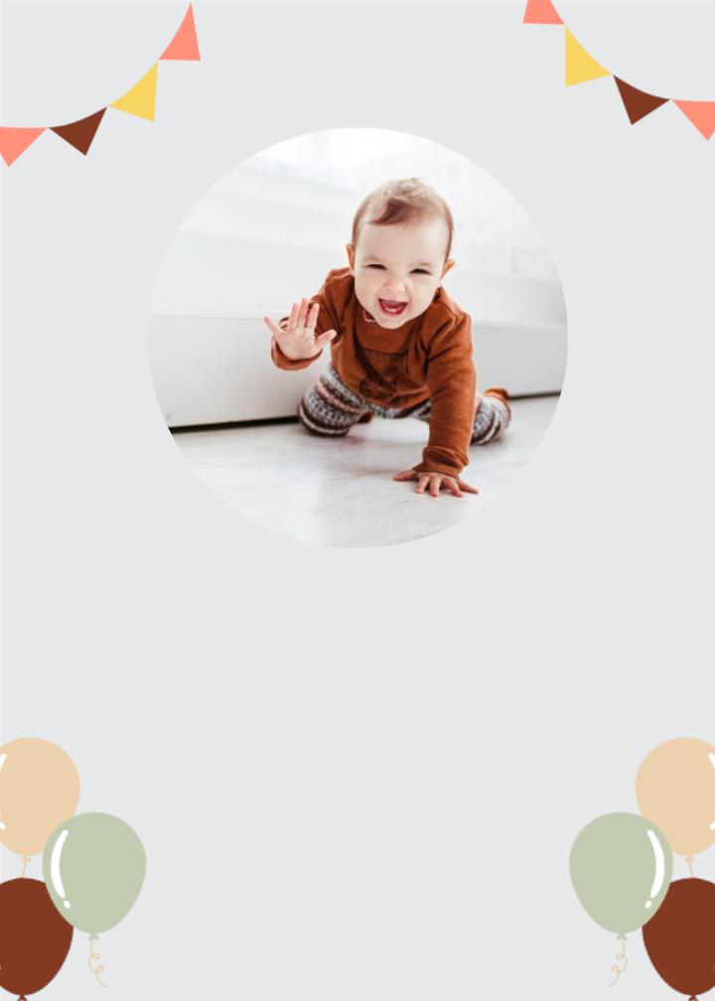
Y O U A R E
I N V I T E D T O
Pedro's Birthday
Sunday 14 August
At 08.00-End
123 Anywhere st., Any City
OSSTET.CO.IN

Slide 13

Birthday
Party
05 July, 2023 | 9:00 am
123 Anywhere St., Any City
OSSTET.CO.IN

Slide 14

Birthday Party
Olivia Wilson
4th
16 July, 2023 Thursday 9:450 am
123 Anywhere St., Any City,
ST 12345
See you at the party
OSSTET.CO.IN

Slide 15

Birthday
Celebrating
William
SUNDAY
12:00 PM
William House
123 Anywhere St, Any City,
ST 12345
OSSTET.CO.IN

Slide 16

Christening
PLEASE JOIN US FOR THE
OF OUR DAUGHTER
Amelia
APRIL
9
2023
SUNDAY | 10 AM
Saint Church
123 ANYWHERE ST., ANY CITY
RSVP: 123-456-7890
OSSTET.CO.IN

Slide 17
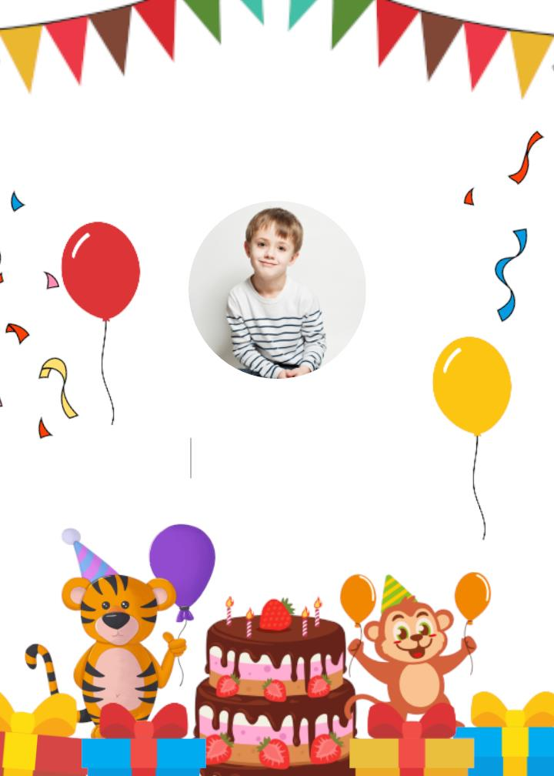
PLEASEꢀJOINꢀUSꢀFORꢀA
Birthday Party
DANIEL
15
NOV
sundayꢀ2:00ꢀ-ꢀ5:00ꢀpm
123ꢀAnywhereꢀSt.,ꢀAnyꢀCity

Slide 18

YOU'RE INVITED
BIRTHDAY
PARTY
JULY 28, 2022
123 ANYWHERE ST., ANY
CITY
OSSTET.CO.IN

Slide 19

Please Join Us for a
Birthday
Party
Celebrating
Marselina
SUNDAY
JULY
12:00 PM
25
Marcelina House
OSSTET.CO.IN

Slide 20

You are invited to a
birthday
party
Kimberley's
Turning 5
12 April 2024
123 Anywhere St., Any City
RSVP with Avery Davis | 123-456-7890
OSSTET.CO.IN

